Slide 1
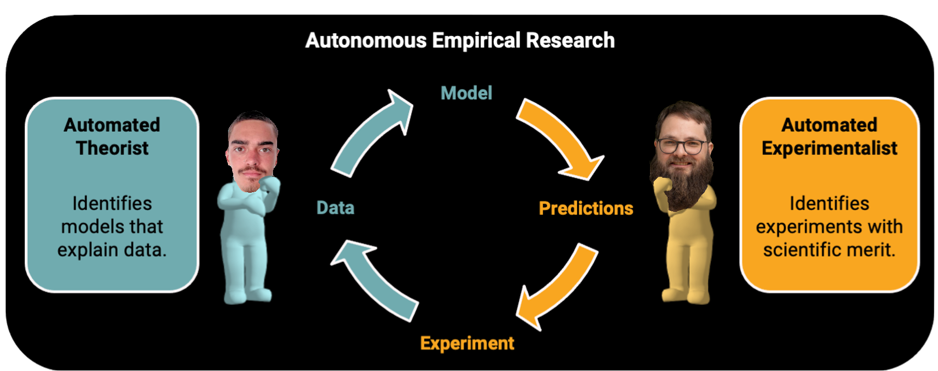
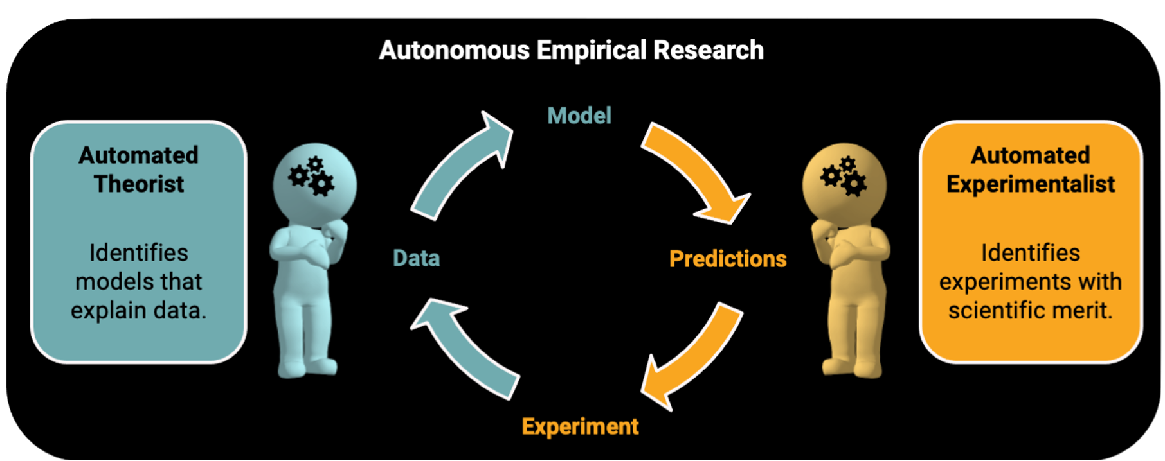
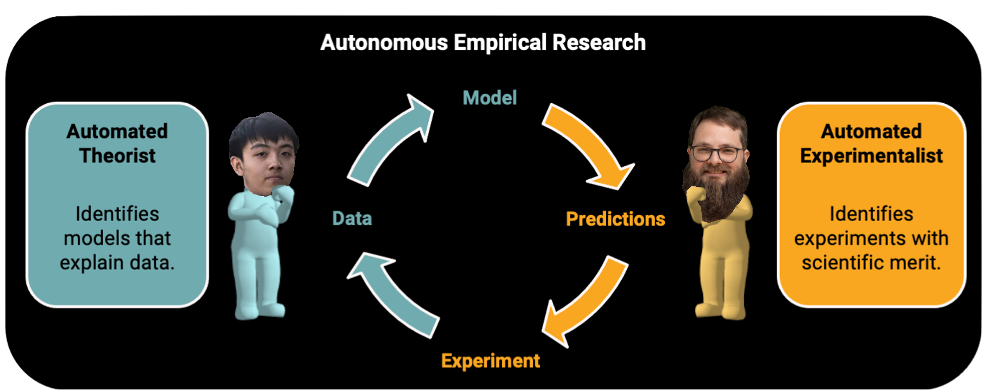

Slide 2
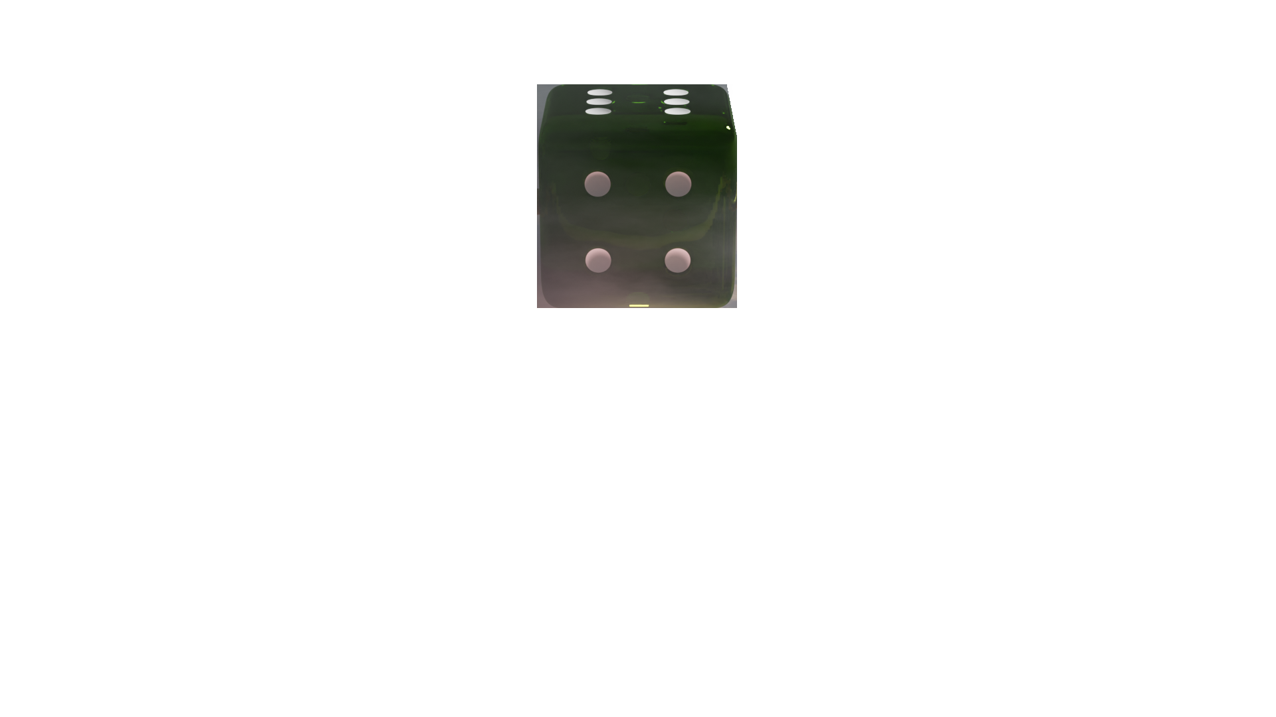
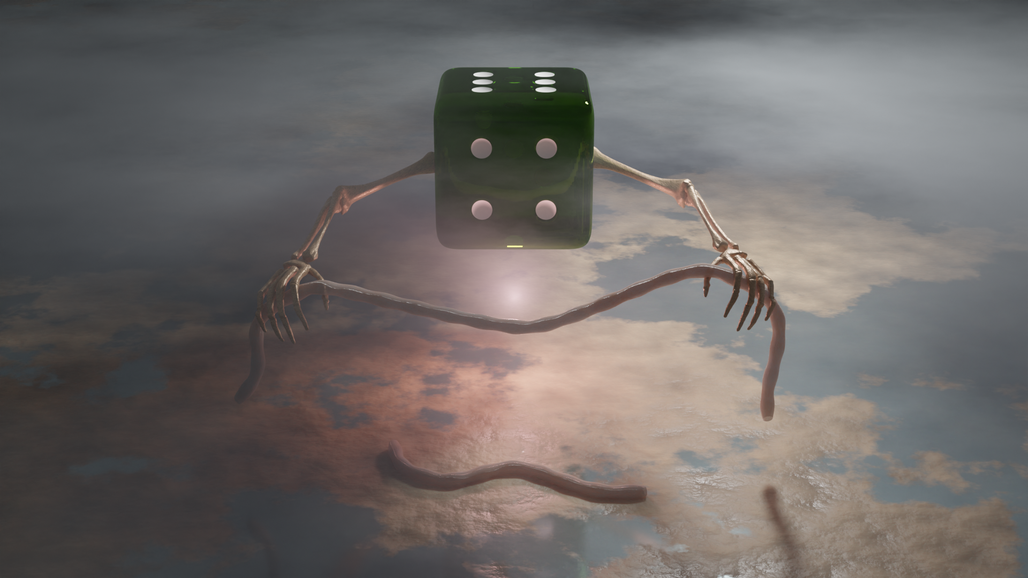
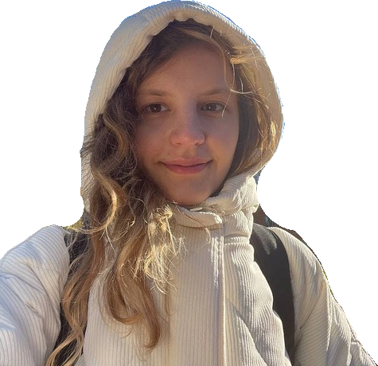
Title
RANDOM
SAMPLING
CLOSED
LOOP
EXPERIMENTALIST

Slide 3
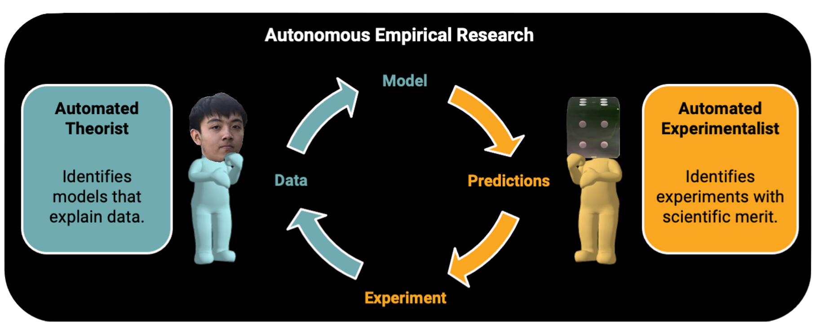
X
RANDOMLY SAMPLES EXPERIMENTS
Doesn’t use
X

Slide 4
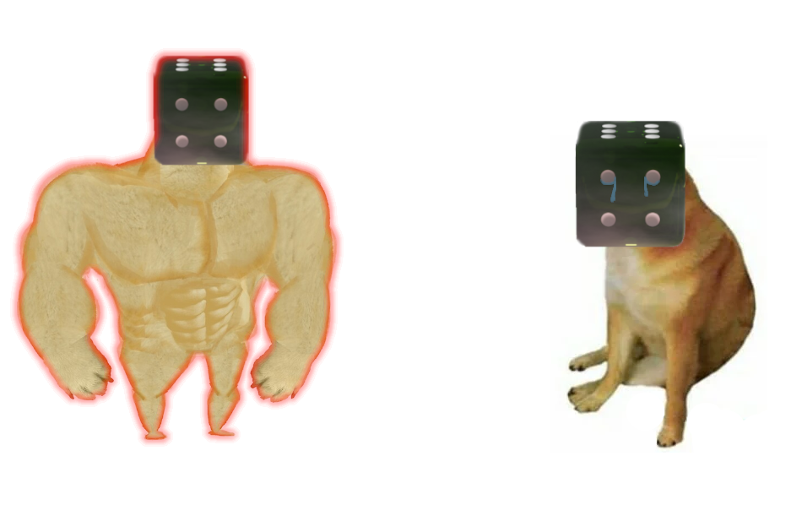
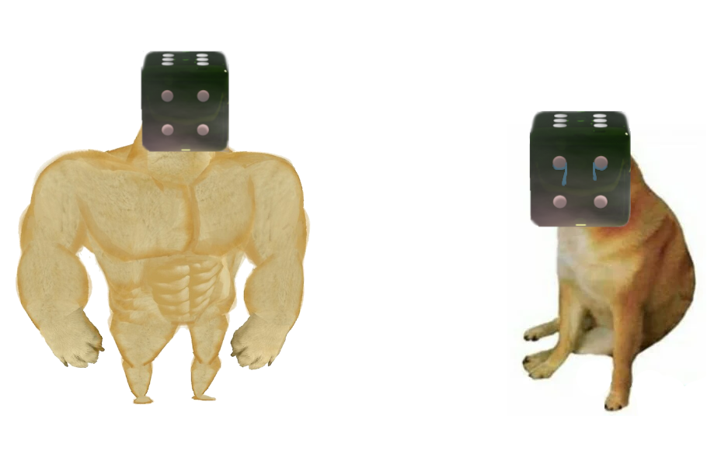
ISN’T RANDOM SAMPLING SUPER WEAK?
Against theory-motivated experimentation in science.
Dubova, M., Moskvichev, A., & Zollman, K.
NO!!!
Explore your experimental designs and theories before you exploit them!
Dubova, M., Sloman, S. J., Andrew, B., Nassar, M. R., & Musslick, S.
An Evaluation of Experimental Sampling Strategies for Autonomous Empirical Research in Cognitive Science
Musslick, S., Hewson, J.T., Andrew, B.W., Strittmatter, Y., Williams, C.C., Dang, G.T., Dubova, M. and Holland, J.G.

Slide 5
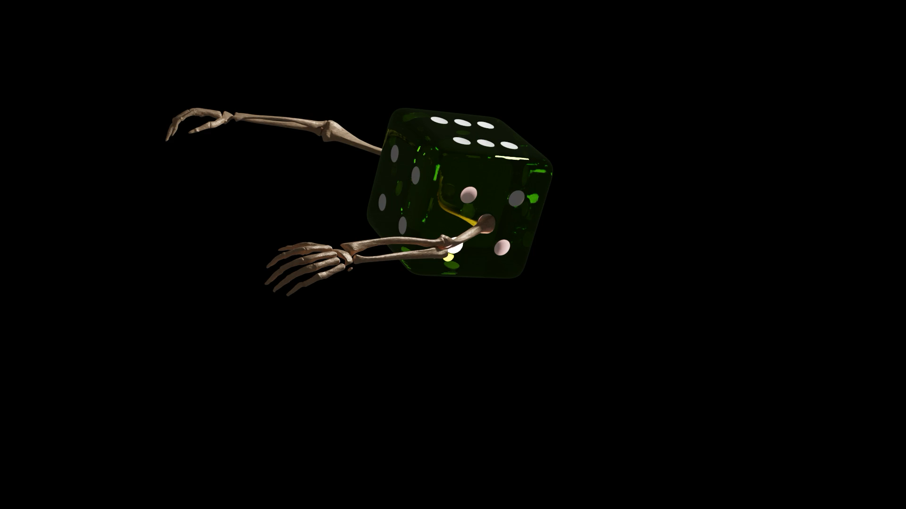
RANDOM SAMPLING IS SCARY!!!

Slide 6
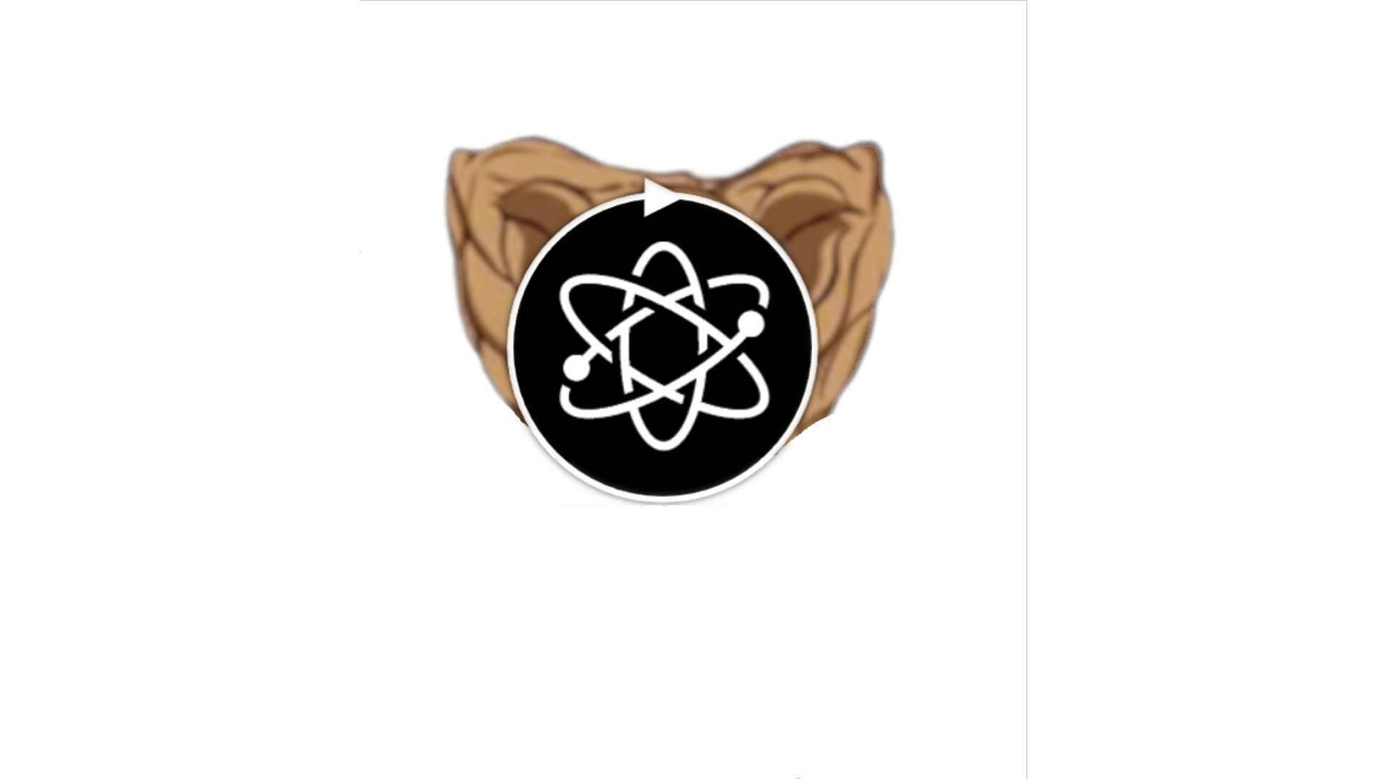
Paper-Motivation
But also a HUGE opportunity:
(1) Underdeveloped Research Area
All you need to “beat” is random sampling
The theory-driven samplers were mostly using a “single” and “simple” strategy
We have the most excellent tools for developing & benchmarking sampling strategies!!!
+ Equation Sampler

Slide 7
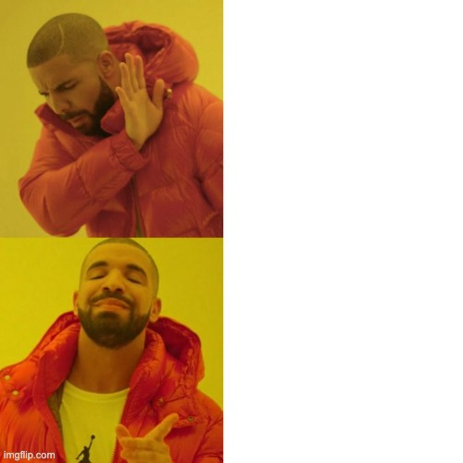
Paper-Motivation
But also a HUGE opportunity:
(2) Embrace Randomness in Integrative Desings
Randomize
Experimental
Conditions
Randomizing Experimental Conditions is easy, since the space is known. But it doesn’t “explore” the space.
Randomizing Experiments is hard, since we do not (yet) have the tools to create the space. But building this space is a huge opportunity.
Randomize
Experiments

Slide 8


Why is random sampling so good?
Random sampling > Theory driven sampling
Lack of exploration?
Random sampling > Novelty sampling (grid)

Slide 9

Y
1
1
X

Slide 10
My best Bet: Bayesian Surprise Sampler
First goal: We want an experimentalist that explores the environment.

Slide 11
My best Bet: Bayesian Surprise Sampler
First goal: We want an experimentalist that explores the environment.
We could reward novelty

Slide 12
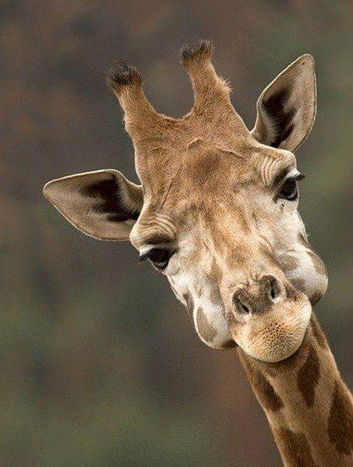
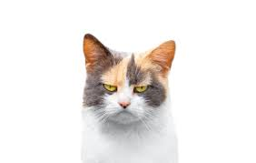
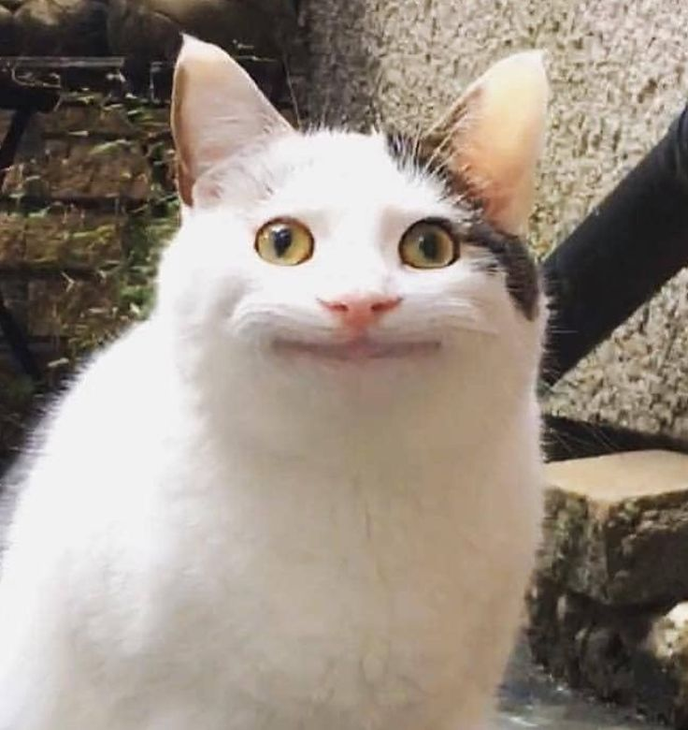
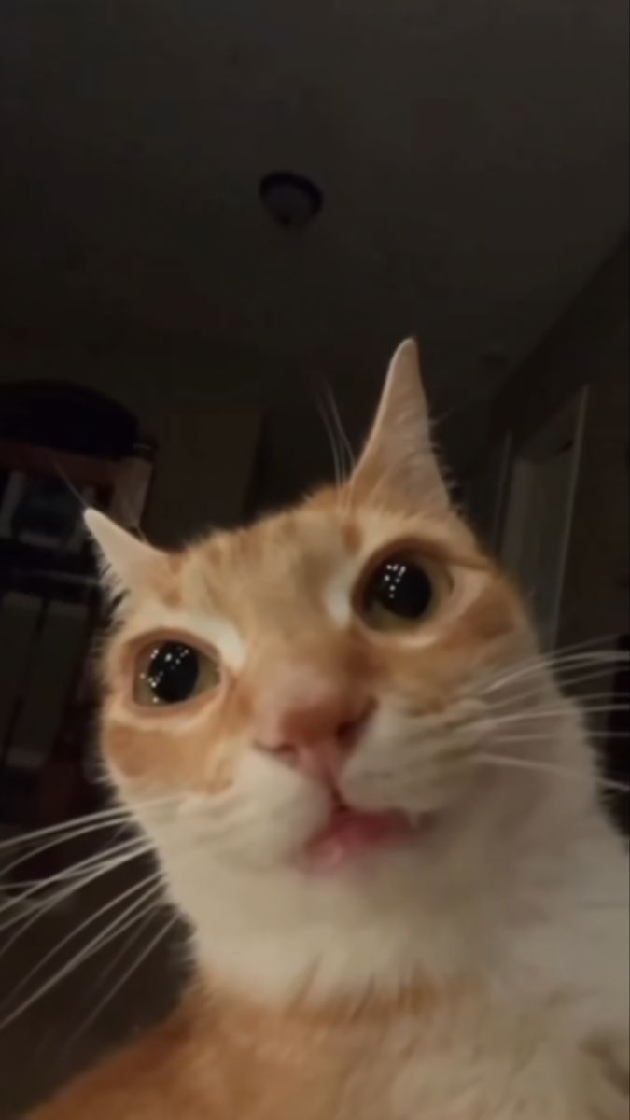
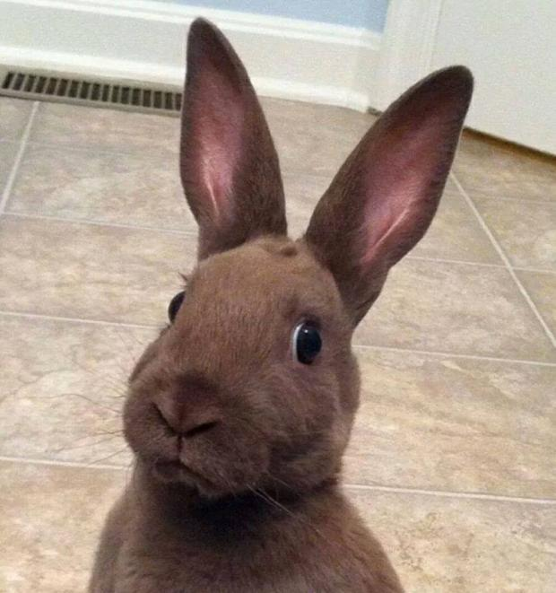
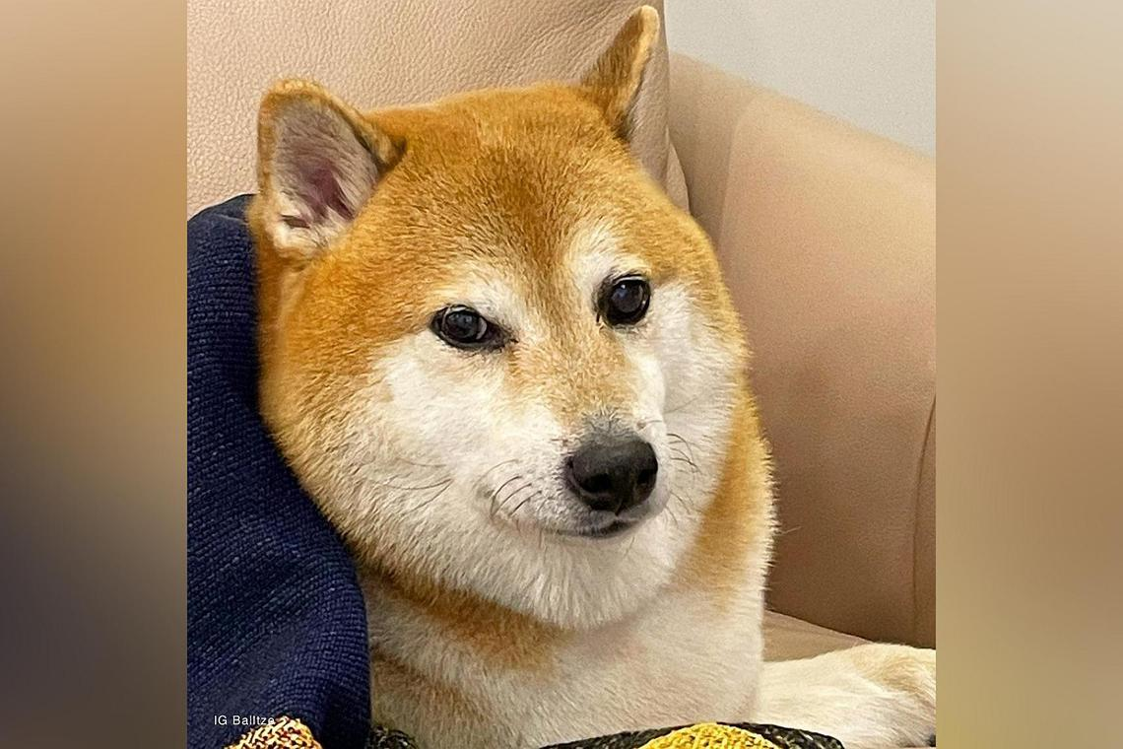
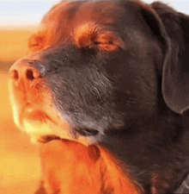
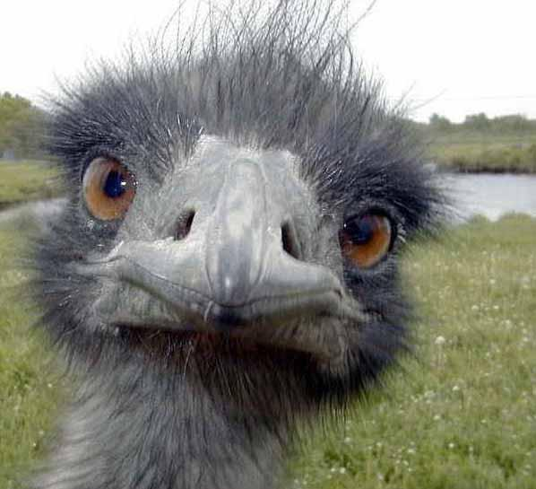
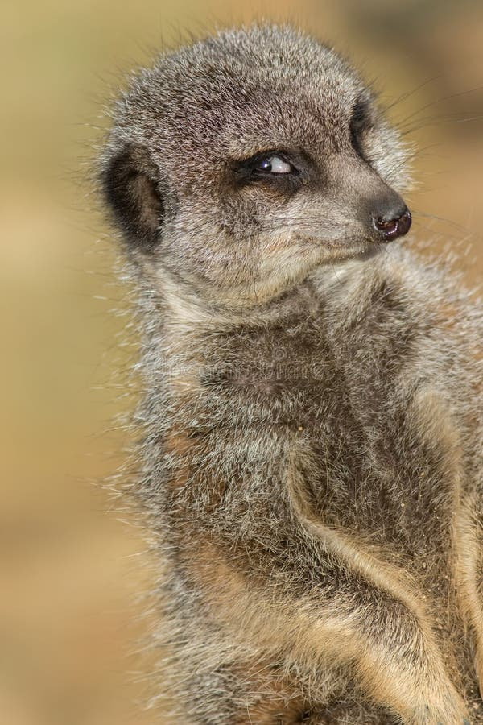
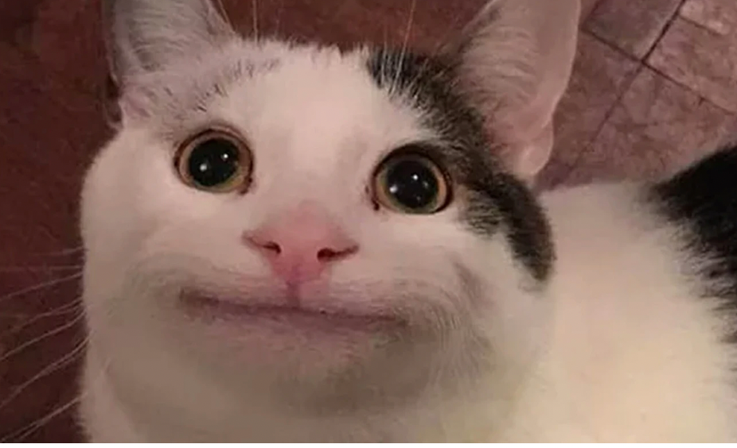
What to learn next?
Already Learned

Slide 13
Already Learned
Most “different”

Slide 14
What is the most different picture to this picture?

Slide 15

What is the most different picture to this picture?

Slide 16
What is the most different picture to this picture?

Slide 17

What is the most different picture to this picture?

Slide 18
Let’s learn then!

Slide 19
Let’s learn then!

Slide 20
Novelty != Information
What we really want: Novelty + Information (Bayesian Surprise)
The best condition is the condition that changes your model the most
Or
The best condition is the condition that updates your believe the most

Slide 21
My proposed Experimentalist:
Not only try to predict observations but also try to create a map of “noisiness”:
-> Given noise is not “uniformly distributed on all conditions”
(2) Use the condition that is most novel but least noisy (or even better have a direct
measurement of expected Bayesian surprise
(3) In simulations this works (retrospectively choosing the conditions that “changed”
the models the most)
(4) Challenge: Find an algorithm that can predict Bayesian surprise reliably

Slide 22
Integrative Experiment Design
Appendix: Integrative Experiment Design

Slide 23
Integrative Experiment Design
Appendix: Integrative Experiment Design
Integrative Experimental Design aims to unify the task space and make it “searchable”
Bottom up (super experiment)
Top down (collective intelligence, Almaatouq)
Via embeddings (sweetBean)

Slide 24
In integrative Designs, the goal might not be to find the best
condition, but simply to filter out the worst.

Slide 25
Integrative Experiment Design
Appendix: Experimental Conditions
RED
GREEN
Regular Factors: color, word
Interaction Factors: color == word? (congruency)
Transition Factors: congruency(n-1) -> congruency(n)
Frequency Factors: N(congruent)/N(incongruent)
…

Slide 26
Integrative Experiment Design
Appendix: Experimental Conditions
RED
GREEN
With SweetPea, we can “find” conditions in data (that might not be counterbalanced) -> check if they are interesting (do they have an effect on observation) -> if so, create new experiment counterbalancing them

Slide 27
THANK YOU!

